Slide 1
Technology in Action
Alan Evans • Kendall Martin
Mary Anne Poatsy
Eleventh Edition
Notes:
Welcome to Chapter 13: Behind the Scenes: How the Internet Works

Slide 2
Technology in Action
Chapter 13
Behind the Scenes: How the Internet Works
Notes:
This chapter takes you behind the scenes of the Internet. We will look at how the Internet works and the various standards it follows. Along the way, we will also go behind the scenes of some Internet communication features, such as e-mail and instant messaging services. We will discuss just how safe these features are and what you can do to make your communications even more secure.

Slide 3
Chapter Topics
Inner Workings of the Internet
The Management of the Internet
Internet Networking, Data Transmission, and Protocols
Internet Identity: IP Addresses and Domain Names
Coding and Communicating on the Internet
HTML, XML, and Other Web Building Blocks
Communications Over the Internet
Notes:
Chapter topics include the following:
Inner Workings of the Internet
The Management of the Internet
Internet Networking, Data Transmission, and Protocols
Internet Identity: IP Addresses and Domain Names
Coding and Communicating on the Internet
HTML, XML, and Other Web Building Blocks
Communications Over the Internet

Slide 4
The Management of the Internet
Ownership of the Internet
Local networks are owned by:
Individuals
Universities
Government agencies
Private companies
Infrastructure (high-speed data lines) is owned by:
Government entities
Privately held companies
Notes:
The local networks that constitute the Internet are owned by different entities, including individuals, universities, government agencies, and private companies.
Government entities such as the National Science Foundation (NSF), as well as many privately held companies, own pieces of the communications infrastructure (the high-speed data lines that transport data between networks) that makes the Internet work.

Slide 5
The Management of the Internet (cont.)
Nonprofit organizations and user groups
Each has a specialized purpose
Previously handled by U.S. government contractors
Guarantees worldwide engagement in the direction of the Internet
Notes:
Several nonprofit organizations and user groups, each with a specialized purpose, are responsible for the Internet’s management.
Many of the functions handled by these nonprofit groups were previously handled by U.S. government contractors because the Internet developed out of a defense project.
However, because the Internet serves the global community, assigning responsibilities to organizations with global membership is the best way to guarantee worldwide engagement in determining the direction of the Internet.

Slide 6
The Management of the Internet (cont.)
Paying for the Internet
National Science Foundation (NSF)
Pays for large part of infrastructure
Funds research and development for new technologies
Through federal taxes
Other countries participate as well
Notes:
The National Science Foundation (NSF), which is a U.S. government–funded agency, still pays for a large portion of the Internet’s infrastructure and funds research and development for new technologies.
The primary source of NSF funding is federal taxes. Other countries also pay for Internet infrastructure and development.

Slide 7
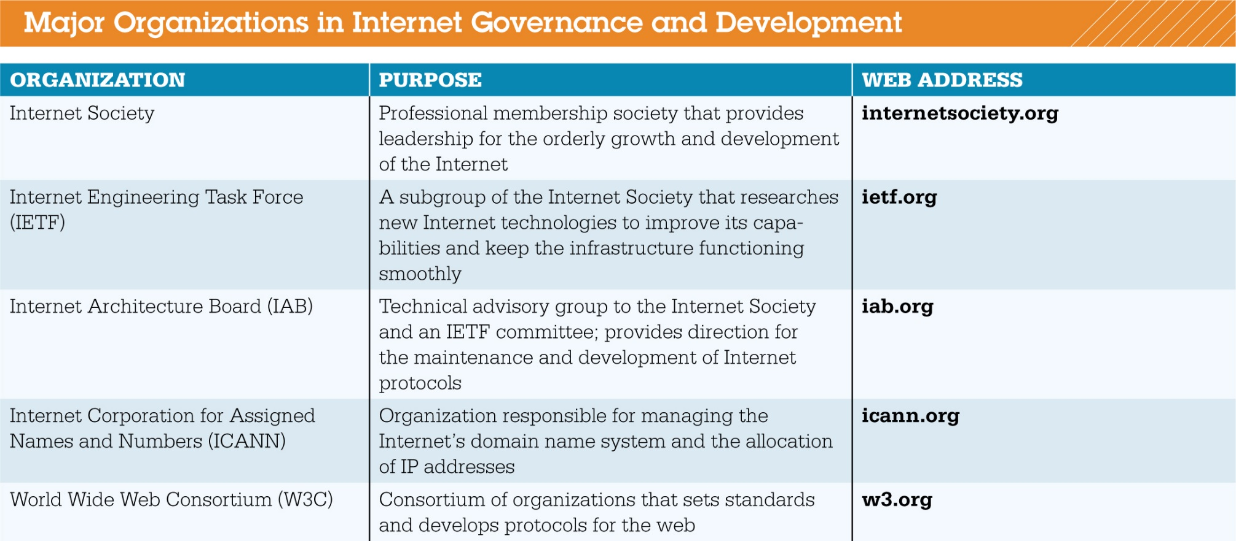
The Management of the Internet (cont.)
Notes:
Figure 13.1 shows some of the major organizations that play a part in internet governance and development.

Slide 8
Internet Networking Internet Data Routes
How computers are connected to the Internet
Internet is a “network of networks”
Main paths known collectively as Internet backbone
Have fastest connections
Notes:
As a “network of networks,” the Internet is similar to the U.S. highway system, where smaller roads feed into larger, faster highways.
The main paths of the Internet, along which data travels the fastest, are known collectively as the Internet backbone.
The Internet backbone is a collection of large national and international networks, most of which are owned by commercial, educational, or government organizations.
These backbone providers, which are required to connect to other backbone providers, have the fastest high-speed connections.

Slide 9
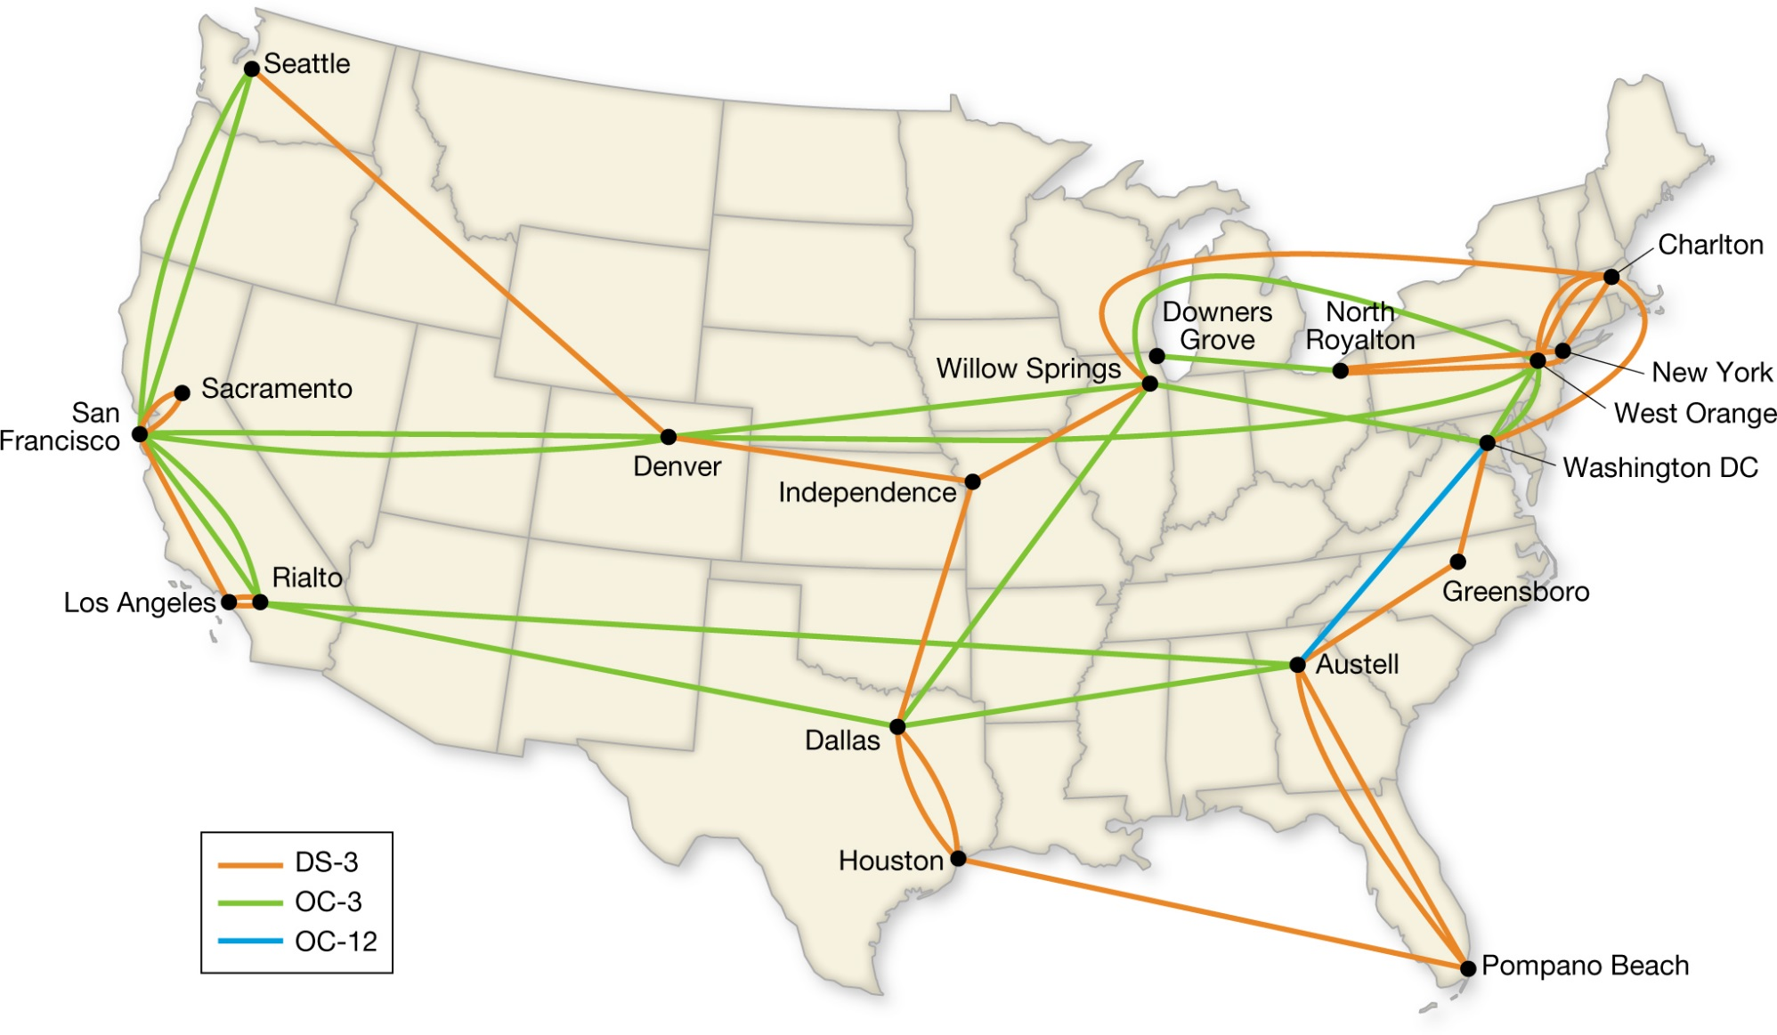
Internet Networking Internet Data Routes (cont.)
Notes:
Here is an example of a typical internet backbone provided by a single company. Large U.S. companies that provide backbone connectivity include Verizon, AT&T, and Sprint.

Slide 10
Internet Networking Internet Data Routes (cont.)
How Internet service providers (ISPs) communicate
Backbone is high-speed fiber optic line known as an optical carrier (OC) line
Come in range of speeds
Originally connected with T lines
Bandwidth needs determine what line is used
Notes:
A backbone is typically a high-speed fiber optic line, designated as an optical carrier (OC) line. OC lines come in a range of speeds, from 0.052 Gbps for OC-1 to the fastest OC-768, which runs at almost 40 Gbps.
Backbone ISPs were initially connected with T lines. A T line carried digital data over twisted-pair wires.
The bandwidth of the connections between ISPs and end users depends on the amount of data traffic required.

Slide 11
Internet Networking Internet Data Routes (cont.)
How ISPs connect to each other
Internet exchange point (IXP)
Made up of one or more network switches
Can reduce costs and improve speed and efficiency of data exchange
Notes:
ISPs like Verizon and Comcast are connected together through an Internet exchange point (IXP). A typical IXP is made up of one or more network switches to which ISPs connect.
Switches are devices that send data on a specific route through a network. By connecting directly to each other through IXPs, networks can reduce their costs and improve the speed and efficiency with which data is exchanged.

Slide 12
Internet Networking Internet Data Routes (cont.)
How individuals connect to an ISP
Point of presence (POP)
ISPs maintain multiple POPs throughout the geographic area they serve
Notes:
Individual Internet users enter an ISP through a point of presence (POP), which is a bank of modems, servers, routers, and switches through which many users can connect to an ISP simultaneously.
ISPs maintain multiple POPs throughout the geographic area they serve.

Slide 13
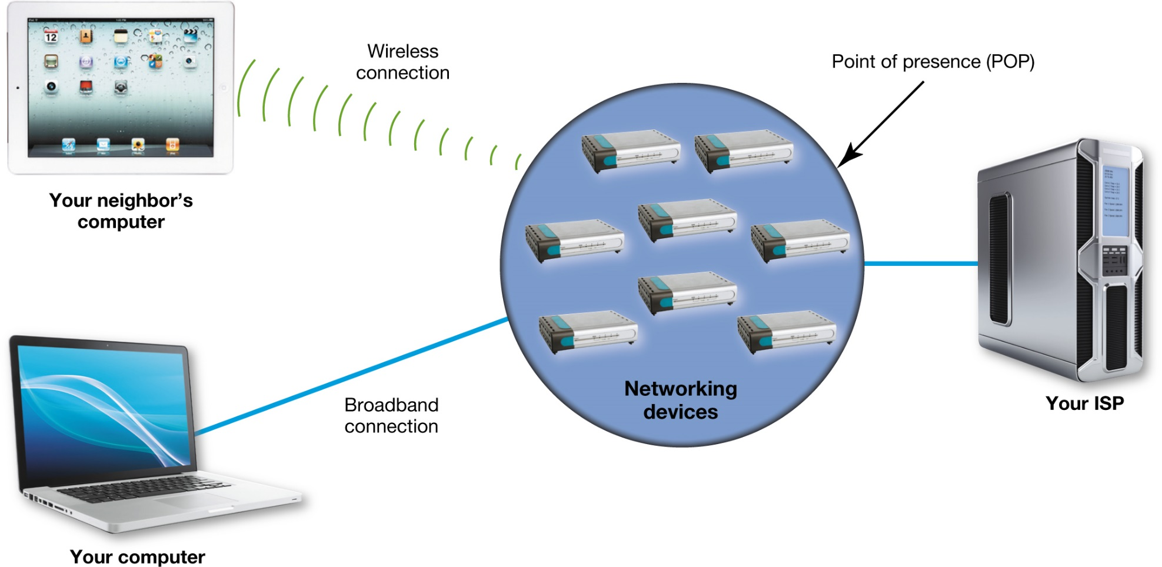
Internet Networking Internet Data Routes (cont.)
Notes:
Figure 13.3 shows how home users connect to their ISPs through a single point of presence that can handle many simultaneous connections.

Slide 14
Internet Networking The Network Model of the Internet
The network model the Internet uses:
Client/server model
Clients are computers, tablets, and smartphones
Clients use browsers to request services
Types of servers
Web servers
Commerce servers
File servers
Notes:
The majority of Internet communications follow the client/server model of network communications. The clients are devices such as computers, tablets, and smartphones that use browsers to request services such as web pages.
Various types of servers are deployed on the networks that make up the Internet:
Web servers: computers that host web pages and other information and to provide requested information to clients
Commerce servers: Computers that enable users to buy goods and services over the web.
File servers: Computers that are deployed to provide remote storage space or to act as storehouses for files that users can download.

Slide 15
Data Transmission and Protocols
Network follows standard protocols to send information
Protocol is a set of rules for exchanging electronic information
Could be considered rules of the road for the information superhighway
Notes:
Just like any other network, the Internet follows standard protocols to send information between computers.
A computer protocol is a set of rules for exchanging electronic information.
If the Internet is the information superhighway, then protocols are the rules of the road.

Slide 16
Data Transmission and Protocols (cont.)
Why Internet protocols were developed
Anyone can communicate using protocol
Common Internet tasks follow same protocols
Allow different topologies to be used
Open systems—design of protocol is made public for access by anyone
Proprietary system—private system was norm
Notes:
The idea of a protocol is that anyone can use it and be able to communicate with any other computer using the same protocol. The most common Internet tasks are all executed the same way on any system following accepted Internet protocols.
When common communication protocols are followed, networks can communicate even if they have different topologies, media, or operating systems.
In an open system, the design of the protocol would be made public for access by any interested party.
This was in direct opposition to the proprietary system (private system) model that was the norm at the time.

Slide 17
Data Transmission and Protocols (cont.)
Problems in developing an open-system Internet protocol
Agreeing on standards was easy
Developing a new method of communication was tough
Circuit switching (technology available in the 1960s) was inefficient for computer communication
Notes:
Agreeing on common standards was relatively easy.
The tough part was developing a new method of communication because the technology available in the 1960s—circuit switching—was inefficient for computer communication.

Slide 18
Data Transmission and Protocols Circuit Switching
Circuit switching
Used since early days of telephone
Dedicated connection is formed between two points
Connection remains active for duration of transmission
Important when order of receiving information is critical
Notes:
Circuit switching has been used since the early days of the telephone for establishing communication. In circuit switching, a dedicated connection is formed between two points (e.g., two people on phones), and the connection remains active for the duration of the transmission.
This method of communication is important when communications must be received in the order in which they’re sent, like phone conversations.

Slide 19
Data Transmission and Protocols Circuit Switching (cont.)
Not used to connect two computers
Inefficient when applied to computers
Computers transmits data in group, or burst
Processor works on next task and ceases to communicate until ready to transmit next burst
Would need to keep circuit open, therefore unavailable, or have to be reestablished for each burst
Notes:
When applied to computers, circuit switching is inefficient. As a computer processor performs the operations necessary to complete a task, it transmits data in a group, or burst.
The processor then begins working on its next task and ceases to communicate with output devices or other networks until it’s ready to transmit data in the next burst.
Circuit switching is inefficient for computers because either the circuit would have to remain open, and therefore unavailable to any other system, with long periods of inactivity, or it would have to be reestablished for each burst.

Slide 20
Data Transmission and Protocols Packet Switching
What computers use to communicate
Makes computer communication efficient
Doesn’t require a dedicated communications circuit
Data is broken into smaller chunks (packets or data packets)
Notes:
Packet switching is the communications methodology that makes computer communication efficient.
Packet switching doesn’t require a dedicated communications circuit to be maintained.
With packet switching, data is broken into smaller chunks called packets (or data packets).

Slide 21
Data Transmission and Protocols Packet Switching (cont.)
What computers use to communicate (cont.)
Packets are sent over various routes at same time
They are reassembled at the destination by receiving computer
Fulfilled original goal of Internet: Data can still travel to destination if a node is disabled or destroyed
Notes:
The packets are sent over various routes at the same time. When the packets reach their destination, they’re reassembled by the receiving computer.
This technology resulted from one of the original goals of creating the Internet: if an Internet node is disabled or destroyed, the data can travel an alternate route to its destination.

Slide 22
Data Transmission and Protocols Packet Switching (cont.)
Packets contain:
An address to which the packet is being sent
The address from where the packet originates
Reassembly instructions, if the original data is split between packets
The data that’s being transmitted
Notes:
Packet contents vary, depending on the protocol being followed. At a minimum, all packets must contain the following:
1. An address to which the packet is being sent
2. The address from where the packet originates
3. Reassembly instructions, if the original data is split between packets
4. The data that’s being transmitted

Slide 23
Data Transmission and Protocols Packet Switching (cont.)
Why packets take different routes
Routers monitor traffic and decide most effective route
Windows utility tracert shows details of exact route request takes to destination server
Notes:
The routers that connect ISPs with each other monitor traffic and decide on the most efficient route for packets to take to their destination.
The router works in the same way a police officer does while directing traffic. To ensure a smooth flow of traffic, police officers are deployed in areas of congestion, directing drivers along alternate routes to their destinations.
The Try This exercise in this chapter uses the Windows tracert utility to show you the details on the exact route your request takes to the destination server.

Slide 24
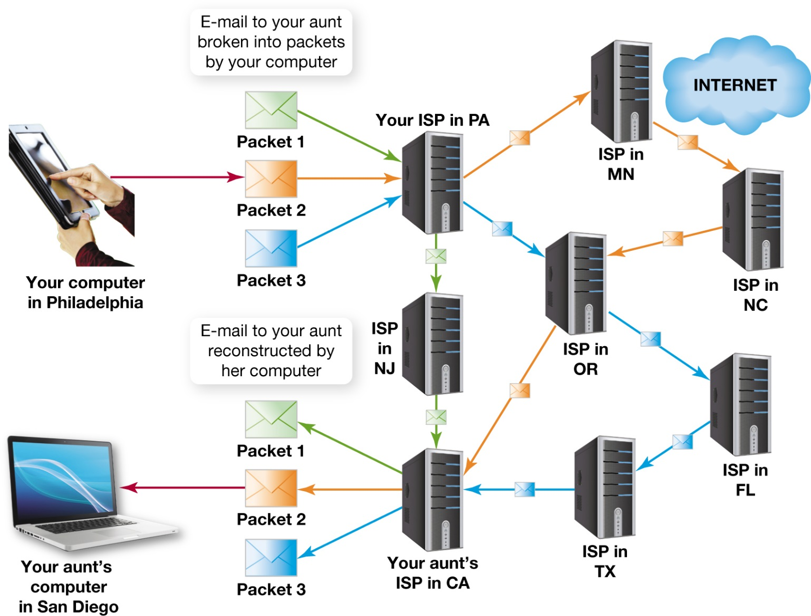
Data Transmission and Protocols Packet Switching (cont.)
Notes:
The packets are sent over various routes at the same time. When the packets reach their destination, they’re reassembled by the receiving computer. This technology resulted from one of the original goals of creating the Internet: If an Internet node is disabled or destroyed, the data can travel an alternate route to its destination.

Slide 25
Data Transmission and Protocols TCP/IP
Protocol the Internet uses for transmitting data
Main suite of protocols is TCP/IP
Transmission Control Protocol (TCP)
Internet Protocol (IP)
Consists of many interrelated protocols
Notes:
Although many protocols are available on the Internet, the main suite of protocols used is TCP/IP.
The suite is named after the original two protocols that were developed for the Internet: the Transmission Control Protocol (TCP) and the Internet Protocol (IP).
Although most people think that the TCP/IP suite consists of only two protocols, it actually includes many interrelated protocols.

Slide 26
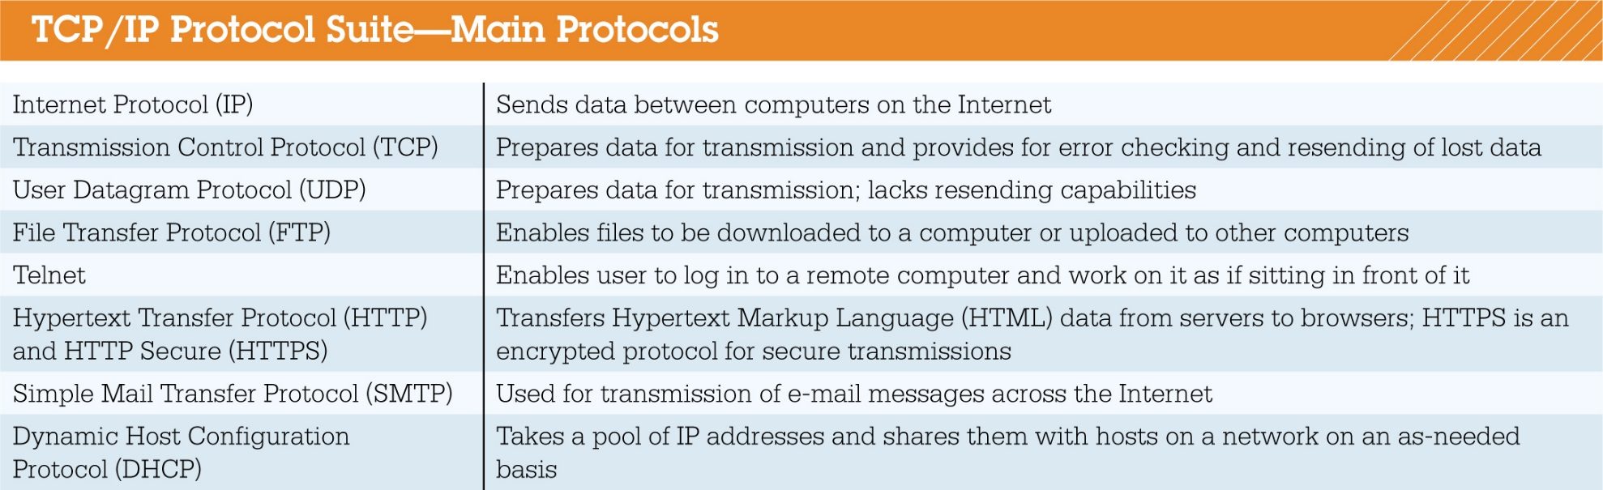
Data Transmission and Protocols TCP/IP (cont.)
Notes:
Figure 13.5 illustrates several of the protocols used for the Internet.
The Internet Protocol (IP) is responsible for sending the information from one computer to another. The IP is like a postal worker who takes a letter (a packet of information) that was mailed (created by the sending computer) and sends it on to another post office (router), which in turn routes it to the addressee (the receiving computer).

Slide 27
Internet Identity: IP Addresses and Domain Names
Each device connected to Internet required to have a unique number
IP address is that unique number
Humans remember words better than numbers
Domain names are word-based IP addresses
Notes:
Each computer, server, or device connected to the Internet is required to have a unique identification number, or IP address.
However, because humans are better at remembering and working with words than with numbers, the numeric IP addresses were given more “human,” word-based addresses.
Thus, domain names were born. We will look at both IP addresses and domain names.

Slide 28
Internet Identity: IP Addresses and Domain Names IP Addresses
IP address
Unique number defines each connected device
Fulfills same function as street address
Must be registered with Internet Corporation for Assigned Names and Numbers (ICANN)
Notes:
An IP address is a unique identification number that defines each computer, service, or other device connected to the Internet.
IP addresses fulfill the same function as street addresses.
IP addresses must be registered with the Internet Corporation for Assigned Names and Numbers (ICANN) to ensure they’re unique and haven’t been assigned to other users. ICANN is responsible for allocating IP addresses to network administrators.

Slide 29
Internet Identity: IP Addresses and Domain Names IP Addresses (cont.)
What an IP address looks like
Typical IP address: 197.169.73.63
Dotted decimal number (dotted quad)
Binary form is 11000101.10101001.01001001.00111111
Referred to as an octet
Considered 32-bit numbers
Can represent 4,294,967,296 values
Notes:
A typical IP address is expressed as follows: 197.169.73.63. An IP address in this form is called a dotted decimal number (or a dotted quad).
The same IP address in binary form is as follows: 11000101.10101001.01001001.00111111. Each of the four numbers in a dotted decimal number is referred to as an octet.
Because 32 positions are available for IP address values, IP addresses are considered 32-bit numbers. The entire 32-bit address can represent 4,294,967,296 values.

Slide 30
Internet Identity: IP Addresses and Domain Names IP Addresses (cont.)
Because of limited number of IP addresses, classless interdomain routing (CIDR) was developed
Allows single IP address to represent several unique IP addresses (supernetting)
Adds a network prefix to end of last octet (/25)
Notes:
Because IPv4 offers only a fixed number of IP addresses, a different addressing scheme, known as classless interdomain routing (CIDR) was developed.
CIDR, or supernetting, allows a single IP address to represent several unique IP addresses by adding a network prefix, represented by a slash and a number, to the end of the last octet.
For example “/25”, indicates that the first 25 bits are used as the unique network identifier.

Slide 31
Internet Identity: IP Addresses and Domain Names IP Addresses (cont.)
Other Internet addressing systems
Internet Protocol version 6 (IPv6), developed by IETF, uses 128-bit addressing instead of 32-bit
XXXX:XXXX:XXXX:XXXX:XXXX:XXXX:XXXX:XXXX
Each X is a hexadecimal digit
Hexadecimal is base-16 number system
Uses 0–9 or A–F
Notes:
Internet Protocol version 6 (IPv6) is an IP addressing scheme developed by the IETF to make IP addresses longer, thereby providing more available IP addresses. IPv6 uses 128-bit addressing instead of 32-bit addressing.
An IPv6 address would have the following format: XXXX:XXXX:XXXX:XXXX:XXXX:XXXX:XXXX:XXXX, where each X is a hexadecimal digit. Hexadecimal is a base-16 number system, and each hexadecimal digit is one of 16 possible values: 0–9 or A–F.

Slide 32
Internet Identity: IP Addresses and Domain Names IP Addresses (cont.)
IPV6
Makes much larger number of IP addresses available (340 followed by 36 zeros)
All modern operating systems handle both IPv4 and IPv6
Majority of routing still uses IPv4
IPv6 conversion will accelerate as IPv4 addresses are running out
Notes:
Hex addressing provides a much larger field size, which will make available a much larger number of IP addresses (approximately 340 followed by 36 zeros).
This should provide a virtually unlimited supply of IP addresses and will allow many different kinds of non-PC devices such as cell phones and home appliances to join the Internet more easily in the future.
All modern operating systems can handle both IPv4 and IPv6 addresses.
Although the majority of routing on the Internet still takes place using IPv4 addresses, the conversion to IPv6 addressing should accelerate now that we’re running out of IPv4 addresses.

Slide 33
Internet Identity: IP Addresses and Domain Names IP Addresses (cont.)
How computer gets IP address (either/or)
Static
IP address never changes
Assigned by network administrator or ISP
Dynamic
IP address is temporary
Assigned from pool of addresses
More common
Notes:
IP addresses are assigned either statically or dynamically:
Static addressing means that the IP address for a computer never changes and is most likely assigned manually by a network administrator or an ISP.
Dynamic addressing, in which your computer is assigned a temporary address from an available pool of IP addresses, is more common. If your ISP uses static addressing, then you were assigned an IP address when you applied for your service and had to configure your computer manually to use that address. More often, though, an ISP assigns a computer a dynamic IP address.

Slide 34
Internet Identity: IP Addresses and Domain Names IP Addresses (cont.)
How dynamic addresses are assigned
Handled by Dynamic Host Configuration Protocol (DHCP)
Belongs to TCP/IP protocol suite
Takes from pool of available addresses on as-needed basis
Assigns address for duration of session
Might not be the same from session to session
Notes:
Dynamic addressing is normally handled by the Dynamic Host Configuration Protocol (DHCP), which belongs to the TCP/IP protocol suite.
DHCP takes a pool of IP addresses and shares them with hosts on the network on an as-needed basis.
The DHCP server assigns each user an IP address for the duration of the session.
Similarly, when you log on to your computer at work in the morning, DHCP assigns an IP address to your computer.
These temporary IP addresses might or might not be the same from session to session.

Slide 35
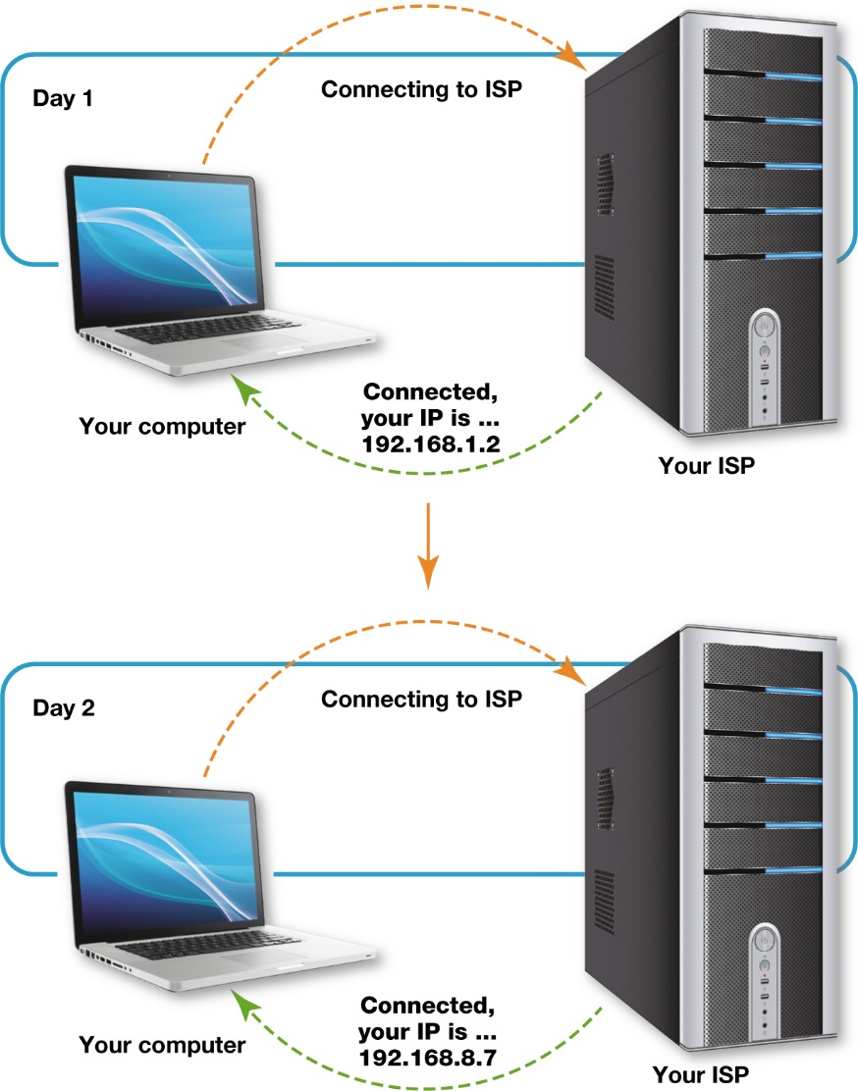
Internet Identity: IP Addresses and Domain Names IP Addresses (cont.)
Benefits of dynamic addressing
Provides more secure environment
Helps keep hackers out of system
Notes:
Although having a static address would seem to be convenient, dynamic addressing provides a more secure environment by keeping hackers out of computer systems.
Imagine how hard it would be for burglars to find your home if you changed your address every day!

Slide 36
Internet Identity: IP Addresses and Domain Names Domain Names
Why IP addresses are not seen
Domain names take the place of IP address
Makes it easier for people to remember
How domains are organized
Organized by level
Establish by ICANN
Within TLDs are many second-level domains
Notes:
A domain name is a name that takes the place of an IP address, making it easier for people to remember.
Domains are organized by level. The portion of the domain name after the dot is the top-level domain (TLD).
The TLDs are standardized pools (e.g., .com and .org) established by ICANN. Within each top-level domain are many second-level domains. A second-level domain is a domain that’s directly below a top-level domain.

Slide 37
Internet Identity: IP Addresses and Domain Names Domain Names (cont.)
Controlling domain name registration
ICANN assigns one company for each TLD
Maintains database of all registered domains and contact information
Country-specific domains controlled by groups in those countries
Complete list of TLDs are found on Internet Assigned Numbers Authority site (iana.org)
Notes:
ICANN assigns companies or organizations to manage domain name registration. Because names can’t be duplicated within a TLD, one company is assigned to oversee each TLD and to maintain a listing of all registered domains.
VeriSign is the current ICANN-accredited domain name registrar for the .com and .net domains. VeriSign provides a database that lists all the registered .com and .net domains and their contact information.
Country-specific domains are controlled by groups in those countries. You can find a complete list of country-code TLDs on the Internet Assigned Numbers Authority website (iana.org).

Slide 38
Internet Identity: IP Addresses and Domain Names Domain Names (cont.)
How computer knows IP address of another computer
Computer converts URL to IP address by consulting database on domain name system (DNS) server
Functions like a phone book for the Internet
Root DNS server—knows location of DNS servers that contain master listings for TLD
Notes:
When you enter a URL in your browser, your computer converts the URL to an IP address.
To do this, your computer consults a database maintained on a domain name system (DNS) server that functions like a phone book for the Internet.

Slide 39
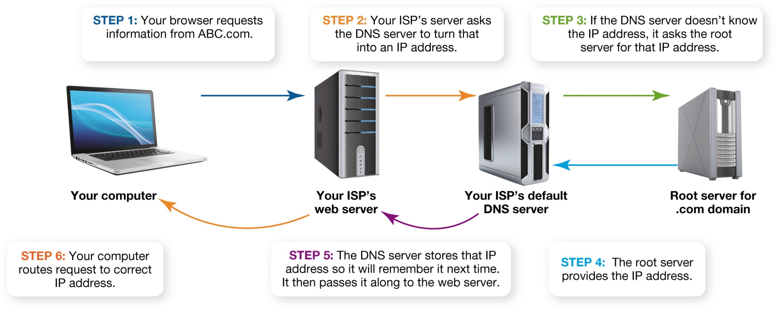
Internet Identity: IP Addresses and Domain Names Domain Names (cont.)
Notes:
Figure 13.11 shows the DNS servers in action.

Slide 40
Coding and Communicating on the Internet
Special languages are used
e.g.HTML
Special protocols
e.g. HTTP
Facilitate communication between computers using different system and application software
Notes:
The web uses special languages such as HTML and protocols such as HTTP to facilitate communication between computers that use different system and application software.
Communication between any two points on the Internet is possible because of HTML and communication protocols. In this part of the chapter, we’ll explore these topics.

Slide 41
HTML, XML, and Other Web Building Blocks HTML
Not a programming language
Set of rules for marking blocks of text
Browser knows how to display
Surrounded by pairs of HTML tags
Tags and text referred to as an element
<b><i>This should be bolded and italicized.</i></b>
Notes:
HTML isn’t a programming language; rather, it’s a set of rules for marking up blocks of text so that a browser knows how to display them. Blocks of text in HTML documents are surrounded by pairs of HTML tags. HTML tags surround and define HTML content. Each pair of tags and the text between them are collectively referred to as an element.
Multiple tags can be combined in a single element:
<b><i>This should be bolded and italicized.</i></b>
The browser would display this element as: This should be bolded and italicized.

Slide 42
HTML, XML, and Other Web Building Blocks HTML (cont.)
HTML5 is current version
Adds modern features
Developers change formatting HTML elements through cascading style sheets
Notes:
HTML5 is the current version of the HTML standard. HTML5 modernizes a number of features in HTML.
A cascading style sheet is a list of rules that defines in one single location how to display HTML elements. Style rules enable a web developer to define a kind of formatting for each HTML element and apply it to all those elements on a set of web pages. Essentially, a template is created on which the formatting for many web pages within a site will be based.

Slide 43
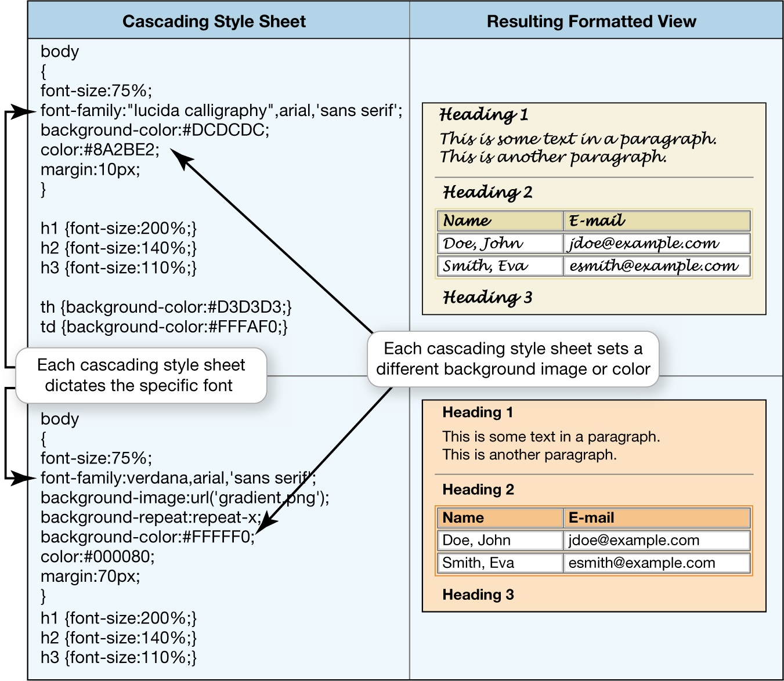
HTML, XML, and other web Building Blocks HTML (cont.)
Notes:
Figure 13.13 Cascading style sheets allow developers to create formatting templates. Just as all the pages of this book have a similar look and feel, one style sheet can control the formatting of many web pages.

Slide 44
HTML, XML, and other web Building Blocks XML and JSON
XML is different from HTML
eXtensible Markup Language (XML) describes what data is rather than how it is displayed
Users build markup languages to accommodate data formats and needs
Provides method of data validation through XML schema diagrams (XSD)
Notes:
The eXtensible Markup Language (XML) describes content in terms of what data is being described rather than how it’s to be displayed. Instead of being locked into standard tags and formats for data, users can build their own markup languages to accommodate particular data formats and needs.
A better approach lies in creating tags that actually describe the data contained within them. In addition, HTML tags don’t provide any methodology for data validation.
XML schema diagrams (XSD) allow you to specify all kinds of data validation for a specific XML tag.

Slide 45
HTML, XML, and other web Building Blocks XML and JSON (cont.)
Custom XML packages
XML has spawned custom packages for specific communities
Goal is information exchange standards
JSON is a popular format to transfer information
Notes:
XML has spawned quite a few custom packages for specific communities. A few examples are listed in Figure 13.14.
These packages illustrate the goal of XML—information exchange standards that can be easily constructed and customized to serve a growing variety of online applications.
There is another very popular format used to transfer information between computers named JSON. It stands for JavaScript Object Notation and is a data interchange standard that is easy for humans to read and write. JSON is faster and easier to use than XML. It consists of name and value pairs like: “firstName” : “Kendall”.

Slide 46
HTML, XML, and other web Building Blocks Web Browser Protocols
Hypertext Transfer Protocol (HTTP) created for transfer of hypertext documents
Hypertext documents have text that is linked to other documents or media
Hypertext Transfer Protocol Secure (HTTPS) ensures data security
Notes:
The Hypertext Transfer Protocol (HTTP) was created especially for the transfer of hypertext documents across the Internet.
(Recall that hypertext documents are documents in which text is linked to other documents or media.)
Hypertext Transfer Protocol Secure (HTTPS) ensures that data is sent securely over the web. HTTPS is actually an acronym that’s the combination of HTTP and Secure Sockets Layer (SSL), a network security protocol.

Slide 47
HTML, XML, and other web Building Blocks Server-Side Applications
Web is a client/server network
Program on server is considered server-side
Can require many communication sessions between client and server
Can perform very complex operations
Notes:
As you’ll recall, the web is a client/server network.
The type of program that runs on a web server rather than on your computer is referred to as a server-side program.
Server-side program execution can require many communication sessions between the client and the server to achieve the goal, but server-side programs can perform very complex operations.

Slide 48
HTML, XML, and other web Building Blocks Server-Side Applications (cont.)
Popular server-side programming choices
Execute on the server
Give web page more sophisticated capabilities
CGI (Common Gateway Interface)
ASP.NET (Active Server Pages)
Notes:
Several methods of designing programs are available that execute on the server and give a web page more sophisticated abilities.
Two of the most popular are CGI (Common Gateway Interface) and ASP.NET (Active Server Pages).

Slide 49
HTML, XML, and other web Building Blocks Server-Side Applications (cont.)
CGI makes a web page more interactive
Most browser requests result in file being displayed in browser
Some programs can perform special actions
Common Gateway Interface (CGI) provides a way to execute a program file
Allows functionality beyond simple display of information
Notes:
Most browser requests merely result in a file being displayed in your browser.
To make a website interactive, you might need to run a program that performs a certain action.
The Common Gateway Interface (CGI) provides a methodology by which your browser can request that a program file be executed instead of just being delivered to the browser.
This enables functionality beyond the simple display of information.

Slide 50
HTML, XML, and other web Building Blocks Server-Side Applications (cont.)
Programming language used to create a CGI program
Can be created in almost any language
Known as CGI scripts
Common languages include Perl and Python
Most common tasks can be accomplished
Notes:
CGI files can be created in almost any programming language, and the programs created are referred to as CGI scripts.
Perl is a common language used to create CGI scripts, but other languages, like Python, offer libraries to support it. Almost any task can be accomplished by writing a CGI script.
One common task is to collect a user’s answers in a form and to create and send out an e-mail message with that information.

Slide 51
HTML, XML, and other web Building Blocks Client-Side Applications
Program that runs on client computer
Requires no interaction with web server
New data is only sent in response to a request
Exchange of data can make interactivity inefficient and slow
More efficient on local computer
Notes:
A client-side program is a program that runs on the client computer and requires no interaction with a web server.
Once a web server processes a web page and sends the page to the client computer that requested it, the receiving computer can’t get new data from the server unless a new request is made.
If interactivity is required on a web page, this exchange of data between the client and server can make the interactivity inefficient and slow.
Often it’s more efficient to run programs on your computer (the client). Therefore, client-side programs are created.

Slide 52
HTML, XML, and other web Building Blocks Client-Side Applications (cont.)
HTML-embedded scripting language tucks programming code directly in HTML tag
Most popular is JavaScript
Applet (small application) is downloaded to client and runs when needed
Most common language is Java
Notes:
There are two main approaches to client-side programming:
1. An HTML-embedded scripting language, which tucks programming code directly within the HTML of a web page. The most popular embedded language is JavaScript.
2. An applet, which is a small application actually located on the server. When requested, the applet is downloaded to the client. It’s there ready to run when needed without additional data transfers between the client and server. The Java language is the most common language used to create applets for use in browsers.

Slide 53
HTML, XML, and other web Building Blocks Client-Side Applications (cont.)
Scripting technologies
Dynamic HTML (DHTML) combines HTML, cascading style sheets, and JavaScript
Creates lively and interactive websites
Allows web page to change after loaded
Occurs in response to user actions
Brings special effects without downloading and installing plug-ins or special software
Notes:
Dynamic HTML (DHTML) is a combination of technologies—HTML, cascading style sheets, and JavaScript— that’s used to create lively and interactive websites. DHTML technologies allow a web page to change (i.e., to be dynamic) after it’s been loaded.
Such change generally occurs in response to user actions, such as when you click your mouse or mouse over objects on a page.
DHTML also brings special effects to otherwise static web pages without requiring users to download and install plug-ins or other special software.

Slide 54
HTML, XML, and other web Building Blocks Client-Side Applications (cont.)
JavaScript
Commonly used scripting language
Creates DHTML effects
Not same as Java programming language
Allows HTML documents to respond to mouse clicks and typing
All actions are executed on client computer
Keeps web pages from being lifeless
Notes:
JavaScript is a commonly used scripting language for creating DHTML effects.
JavaScript is often confused with the Java programming language because of the similarity in their names.
However, although they share some common elements, the two languages are different.
With JavaScript, HTML documents can be made responsive to mouse clicks and typing.
All actions dictated by the embedded JavaScript commands are executed on the client computer.
Without JavaScript and other scripting languages, web pages would be lifeless.

Slide 55
HTML, XML, and other web Building Blocks Client-Side Applications (cont.)
How JavaScript controls the components of a web page
Document Object Model (DOM) is used to organize objects and page elements
Defines every item on a web page as an object
Allows web developers to easily change the look and feel of objects
Notes:
Just as cascading style sheets organize and combine the attributes of objects on a web page, JavaScript uses the Document Object Model (DOM) to organize the objects and page elements.
The DOM defines every item on a web page—including graphics, tables, and headers—as an object.
Then with DOM, similar to cascading style sheets, web developers can easily change the look and feel of these objects.

Slide 56
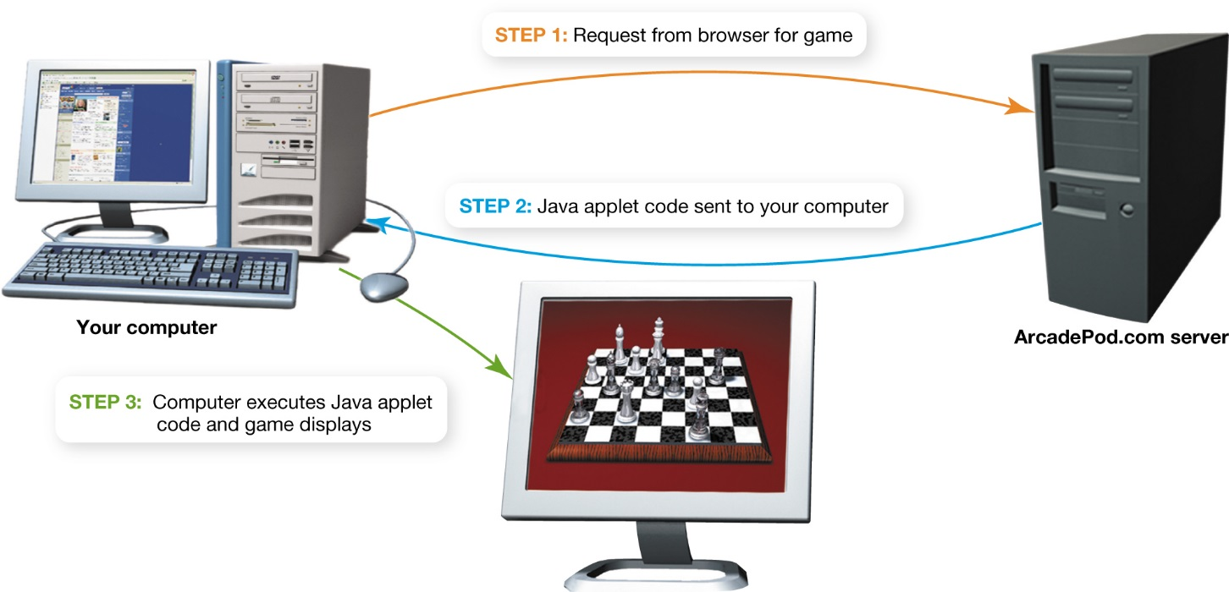
HTML, XML, and other web Building Blocks Client-Side Applications (cont.)
Notes:
Figure 13.16 shows the deployment of a Java applet on a computer.

Slide 57
HTML, XML, and other web Building Blocks Client-Side Applications (cont.)
Where web programming is headed
Web pages interacting with servers at times other than when being fetched
Ongoing exchange of information
Updating information without page refresh or leaving the page
AJAX (Asynchronous JavaScript and XML) facilitates these applications
Notes:
Web pages will be able to interact with servers at times other than when a page is being fetched.
Web pages will have an ongoing exchange of information, communicating with the server and updating information on the page without requiring the user to do a page refresh or leave the page. AJAX is the acronym for Asynchronous JavaScript and XML, a group of technologies that facilitates the creation of this style of web applications.

Slide 58
Communications Over the Internet E-Mail
Invention of e-mail
Ray Tomlinson (1971) helped develop ARPANET (precursor to the Internet)
Enables users to leave text messages for each other on a single machine
Extended to sending text messages between machines on Internet
Became the most popular application
1973: Accounted for 75% of all data traffic
Notes:
In 1971, Ray Tomlinson, a computer engineer who worked on the development of the ARPANET, the precursor to the Internet, created e-mail. E-mail grew from a simple program that Tomlinson wrote to enable computer users to leave text messages for each other on a single machine.
The logical extension of this was sending text messages between machines on the Internet.
E-mail became the most popular application on ARPANET; by 1973, it accounted for 75% of all data traffic.

Slide 59
Communications Over the Internet E-Mail (cont.)
Simple Mail Transfer Protocol (SMTP) sends e-mails along the Internet
Part of the Internet Protocol suite
Is a client/server application
Passes through several e-mail servers
Notes:
Just like other kinds of data that flow along the Internet, e-mail has its own protocol.
The Simple Mail Transfer Protocol (SMTP) is responsible for sending e-mail along the Internet to its destination. SMTP is part of the Internet Protocol suite.
As in most other Internet applications, e-mail is a client/server application.
On the way to its destination, your mail will pass through e-mail servers, specialized computers whose sole function is to store, process, and send e-mail.

Slide 60
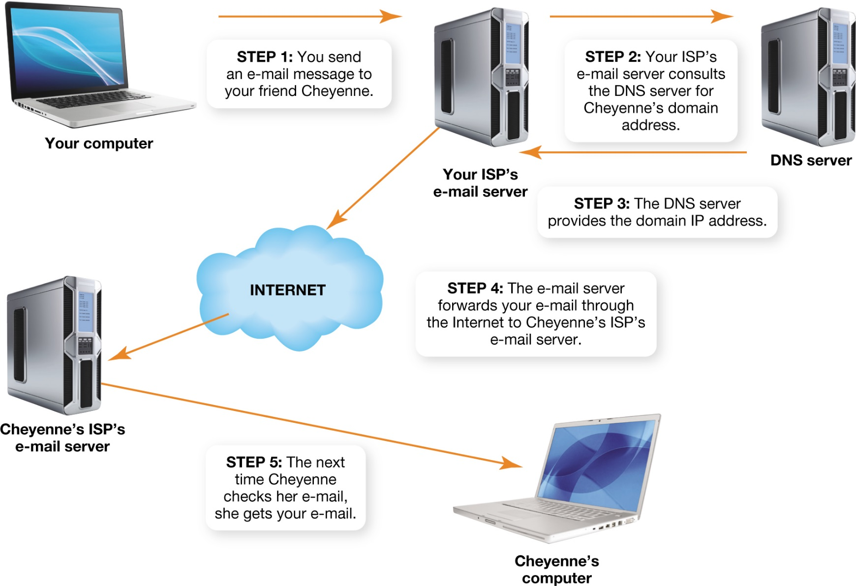
Communications Over the Internet E-Mail (cont.)
Notes:
Figure 13.17 shows a sample route an e-mail takes on the Internet.

Slide 61
Communications Over the Internet E-Mail (cont.)
Sending files as attachments
SMTP handles text messages
Multipurpose Internet Mail Extensions (MIME) specification created to send files
E-mail is sent as text, but MIME handles encoding and decoding of files
Notes:
SMTP was designed to handle text messages.
When the need arose to send files by e-mail, the Multipurpose Internet Mail Extensions (MIME) specification was introduced.
All e-mail client software now uses this protocol to attach files. E-mail is still sent as text, but the e-mail client using the MIME protocol now handles the encoding and decoding for the users.
When attaching a file, your e-mail client transparently encodes and decodes the file for transmission and receipt.

Slide 62
Communications Over the Internet E-Mail Security: Encryption
Email is highly susceptible to being read
It is sent in plain text
Copies might exist on numerous servers
Encryption helps protect sensitive messages
Many e-mail servers offer built-in encryption
Codes e-mail so that only person with key to code can decode the message
Notes:
E-mail is highly susceptible to being read by unintended parties because it’s sent in plain text. Additionally, copies of your e-mail messages might exist on numerous servers as the messages make their way through the Internet. To protect your sensitive e-mail messages, encryption practices are available.
Many e-mail services offer built-in encryption.
Encryption refers to the process of coding your e-mail so that only the person with the key to the code (the intended recipient) can decode (or decipher) the message. There are two basic types of encryption:
1. Private-key encryption
2. Public-key encryption

Slide 63
Communications Over the Internet E-Mail Security: Encryption (cont.)
Private-key encryption
Only the two parties have the code
Could be a shift code
Could be more complex substitution code
Main problem is key security
Notes:
In private-key encryption, only the two parties involved in sending the message have the code. This could be a simple shift code where letters of the alphabet are shifted to a new position.
The main problem with private-key encryption is key security. If someone steals a copy of the code or is savvy about decoding, the code is broken.

Slide 64
Communications Over the Internet E-Mail Security: Encryption (cont.)
Public-key encryption
Two keys (key pair) are created
One for coding, one for decoding
Coding key is distributed as public key
Message being sent is coded using public key
Decode using private key
Only receiver knows private key
Mathematical relationship between two keys
Notes:
In public-key encryption, two keys (key pair) are created. You use one key for coding and the other for decoding.
Anyone wishing to send you a message codes the message using your public key. When you receive the message, you use your private key to decode it. You’re the only one who ever possesses the private key, and therefore it’s highly secure.
The keys are generated in such a way that they can work only with each other. The public key is generated using a complex mathematical formula, often using values from the private key.

Slide 65
Communications Over the Internet E-Mail Security: Encryption (cont.)
Private key’s level of security
Impossible to deduce private key from public key because of complexity of algorithms
In brute force attack, every possible combination is tried
Can enable hackers to deduce key and decode message
Notes:
Because of the complexity of the algorithms used to generate key pairs, it’s impossible to deduce the private key from the public key.
However, that doesn’t mean your coded message can’t be cracked.
A brute force attack occurs when hackers try every possible key combination to decode a message.
This type of attack can enable hackers to deduce the key and decode the message.

Slide 66
Communications Over the Internet E-Mail Security: Encryption (cont.)
What kind of key is considered safe
1990s: 40-bit keys thought to be completely resistant to brute force attacks
1995: French programmer broke 40-bit key
Later: 128-bit keys became standard
Strong encryption calls for 256-bit keys
Could take hundreds of billions of years to crack
Notes:
In the early 1990s, 40-bit keys were thought to be completely resistant to brute force attacks and were the norm for encryption.
However, in 1995, a French programmer broke the 40-bit key in just 8 days.
After this, 128-bit keys became the standard. However, using supercomputers, researchers have had some success cracking 128-bit encryption.
Therefore, strong encryption now calls for 256-bit keys. It’s believed that even with the most powerful computers in use today, it would take hundreds of billions of years to crack a 256-bit key.

Slide 67
Communications Over the Internet Instant Messaging
What you need to run instant messaging
Client program that connects to an instant messaging (IM) service
Examples
Yahoo! Messenger
GoogleTalk
Notes:
Instant messaging (IM) requires the use of a client program that connects to an IM service.
Yahoo! Messenger and GoogleTalk are two IM services in use today.

Slide 68
Communications Over the Internet Instant Messaging (cont.)
How instant messaging works
Client software makes connection with chat server
Provides connection information to your device
Server isn’t involved in chat session
Chatting takes place between two devices over the Internet
Notes:
The client software running on your device makes a connection with the chat server and provides it with connection information for your device (e.g., the IP address).
Because both your device and your friend’s device have the connection information (the IP addresses) for each other, the server isn’t involved in the chat session.
Chatting takes place directly between the two devices over the Internet.

Slide 69
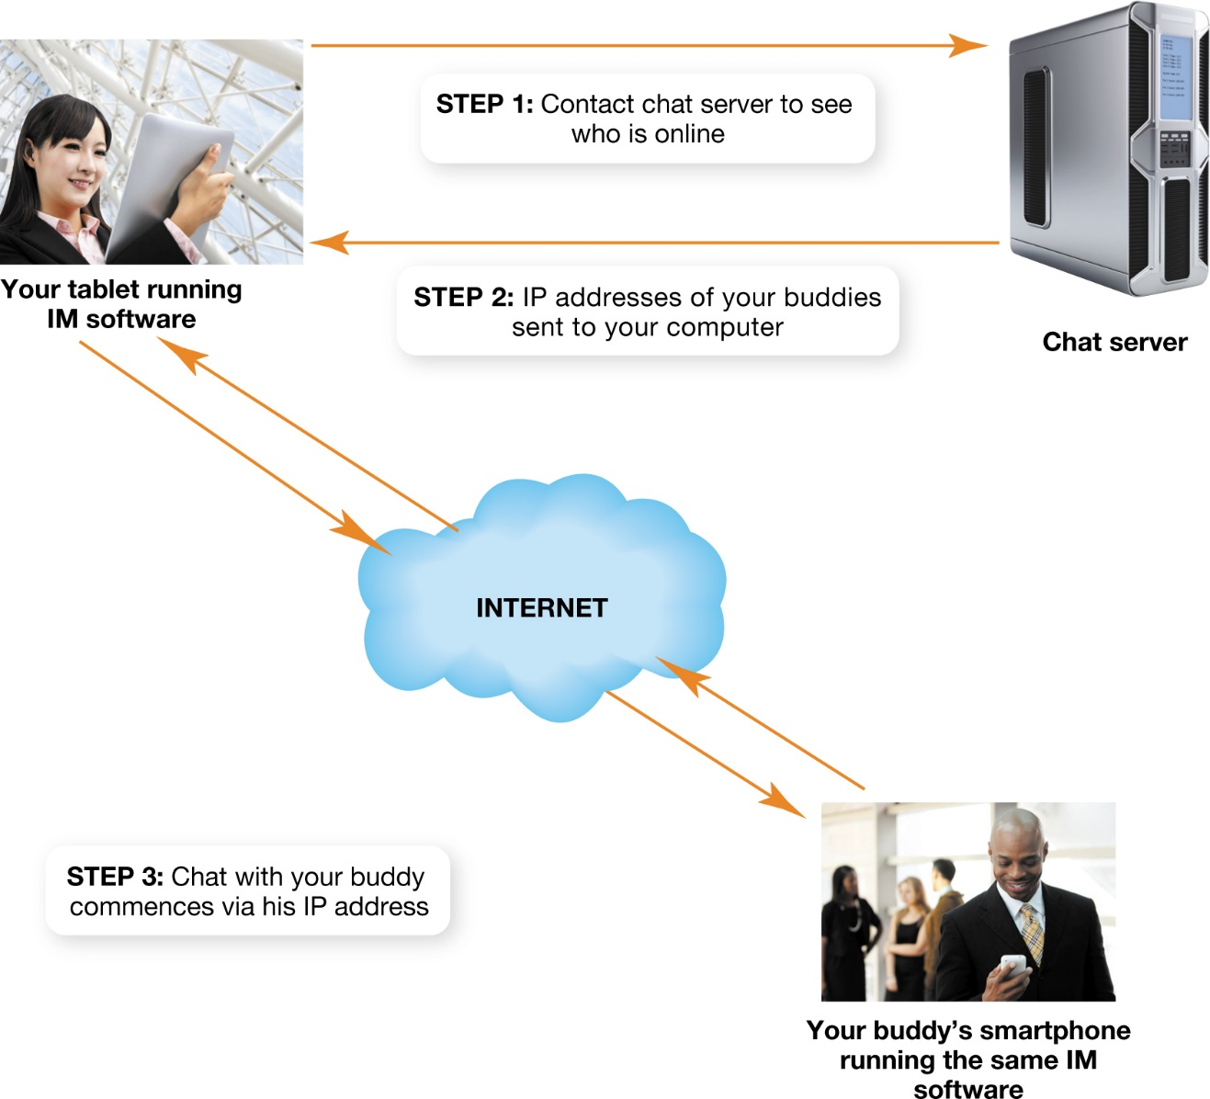
Communications Over the Internet Instant Messaging (cont.)
Notes:
Figure 13.20 shows how an instant messaging program works.

Slide 70
Chapter 13 Summary Questions
1. Who owns, manages, and pays for the Internet?
Notes:
• Management of the Internet is carried out by several nonprofit organizations and user groups such as the Internet Society, the Internet Engineering Task Force (IETF), the Internet Architecture Board (IAB), the Internet Corporation for Assigned Names and Numbers (ICANN), and the World Wide Web Consortium (W3C). Each group has different responsibilities
and tasks.
• Currently, the U.S. government funds a majority of the Internet’s costs. Other countries also pay for Internet infrastructure and development.

Slide 71
Chapter 13 Summary Questions
2. How do the Internet’s networking components interact?
Notes:
• Computing devices or networks connect to the Internet using Internet service providers (ISPs).
• The largest paths of the Internet, along which data travels the most efficiently and quickly, make up the Internet backbone.
• Optical carrier lines are high throughput and are used to connect large corporations to their ISPs.
• Service providers use an Internet exchange point (IXP) to connect directly to each other, reducing cost and latency time.
• Individual users enter their ISP through a point of presence (POP), a bank of routers and switches through which many users can connect simultaneously.

Slide 72
Chapter 13 Summary Questions
3. What data transmissions and protocols does the Internet use?
Notes:
• Data is transmitted along the Internet using packet switching. Data is broken up into discrete units known as packets, which can take independent routes to the destination before being reassembled.
• A computer protocol is a set of rules for exchanging electronic information. Although many protocols are available on the Internet, the main suite of protocols used to move information over the Internet is TCP/ IP: the Transmission Control Protocol (TCP) and the Internet Protocol (IP).
• TCP is responsible for preparing data for transmission, but IP actually sends data between computers on the Internet.

Slide 73
Chapter 13 Summary Questions
4. Why are IP addresses and domain names important for Internet communications?
Notes:
• An IP address is a unique number assigned to all computers connected to the Internet. The IP address is necessary so that packets of data can be sent to a particular location (computer) on the Internet.
• A domain name is merely a name that stands for a certain IP address and that makes it easier for people to remember it.
• DNS servers act as the phone books of the Internet. They enable your computer to find out the IP address of a domain by looking up its corresponding domain name.

Slide 74
Chapter 13 Summary Questions
5. What web technologies are used to develop web applications?
Notes:
• The Hypertext Transfer Protocol (HTTP) is the protocol used to display web pages in your browser.
• The Hypertext Markup Language (HTML) is a set of rules for marking up blocks of text so that a browser knows how to display them.
• HTML5 offers much better support for media like audio and video.
• Because HTML wasn’t designed for information exchange, eXtensible Markup Language (XML) was created. XML enables users to create markup languages to accommodate particular data formats and needs.
• Software is developed on both the server and on the client side to make web pages more responsive and interactive.

Slide 75
Chapter 13 Summary Questions
6. How do e-mail and instant messaging work, and how is information using these technologies kept secure?
Notes:
• Simple Mail Transfer Protocol (SMTP) is the protocol responsible for sending e-mail over the Internet.
• E-mail is a client/server application. E-mail passes through e-mail servers, whose functions are to store, process, and send e-mail to its ultimate destination. ISPs and portals such as Gmail maintain e-mail servers to provide e-mail functionality to their customers.
• Your ISP’s e-mail server uses DNS servers to locate the IP addresses for the recipients of the e-mail you send.
• Encryption software, such as Pretty Good Privacy (PGP), is used to code messages so that they can be decoded only by authorized recipients.

Slide 76
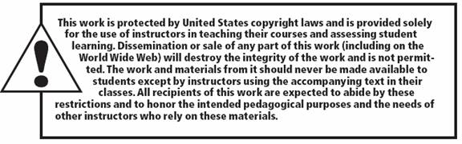
All rights reserved. No part of this publication may be reproduced, stored in a retrieval system, or transmitted, in any form or by any means, electronic, mechanical, photocopying, recording, or otherwise, without the prior written permission of the publisher. Printed in the United States of America.
Copyright © 2015 Pearson Education, Inc.

